Slide 1
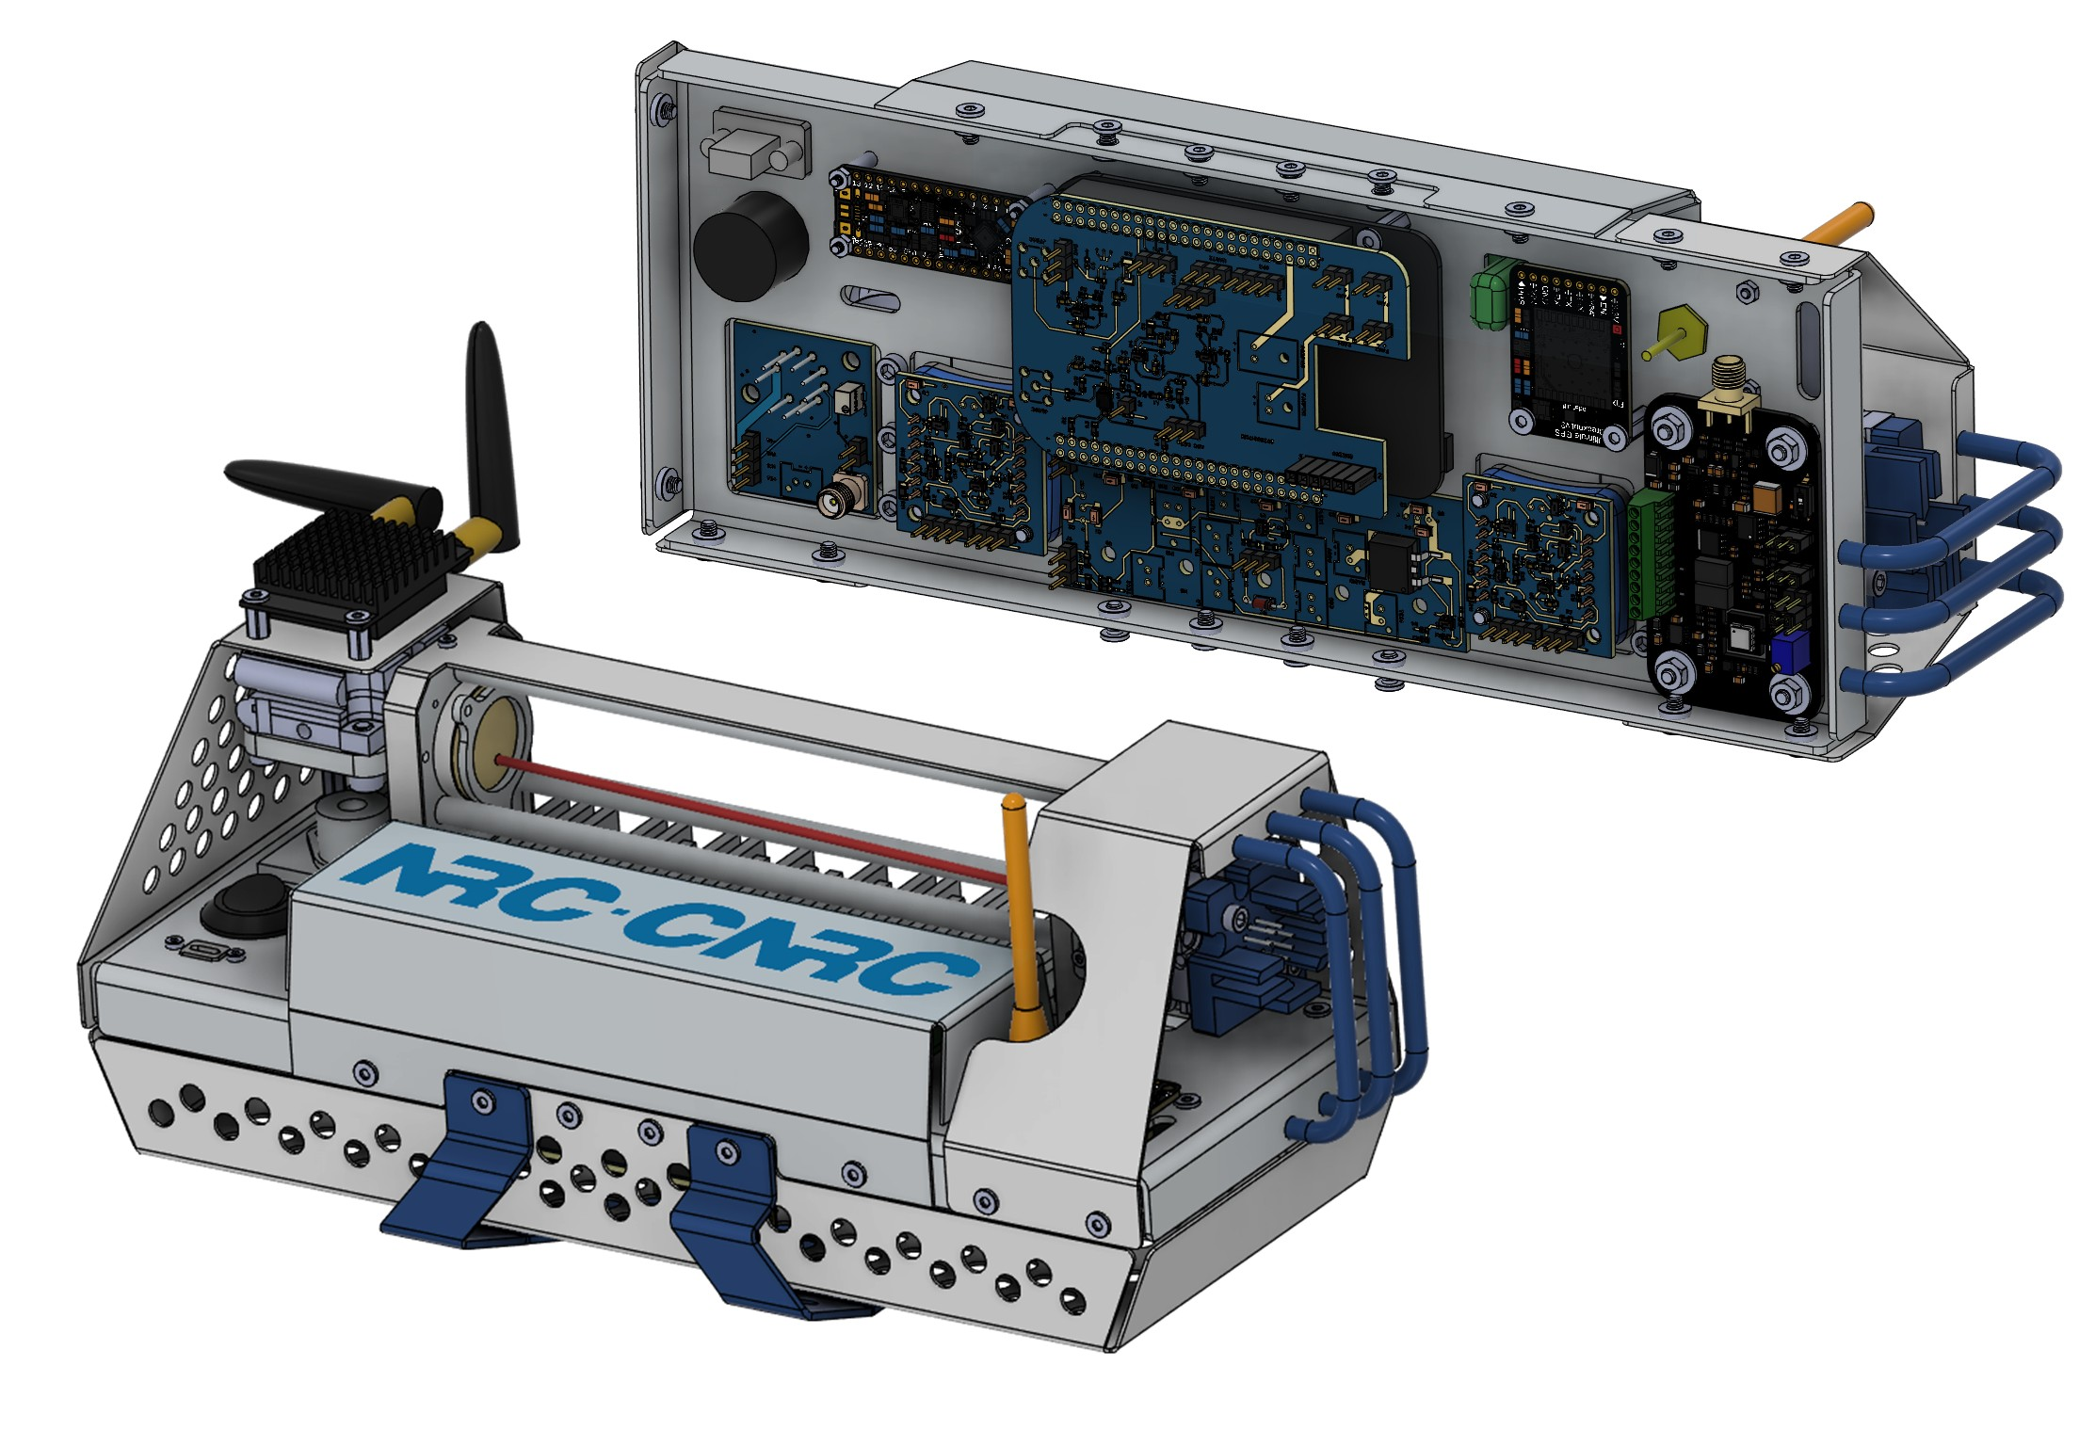
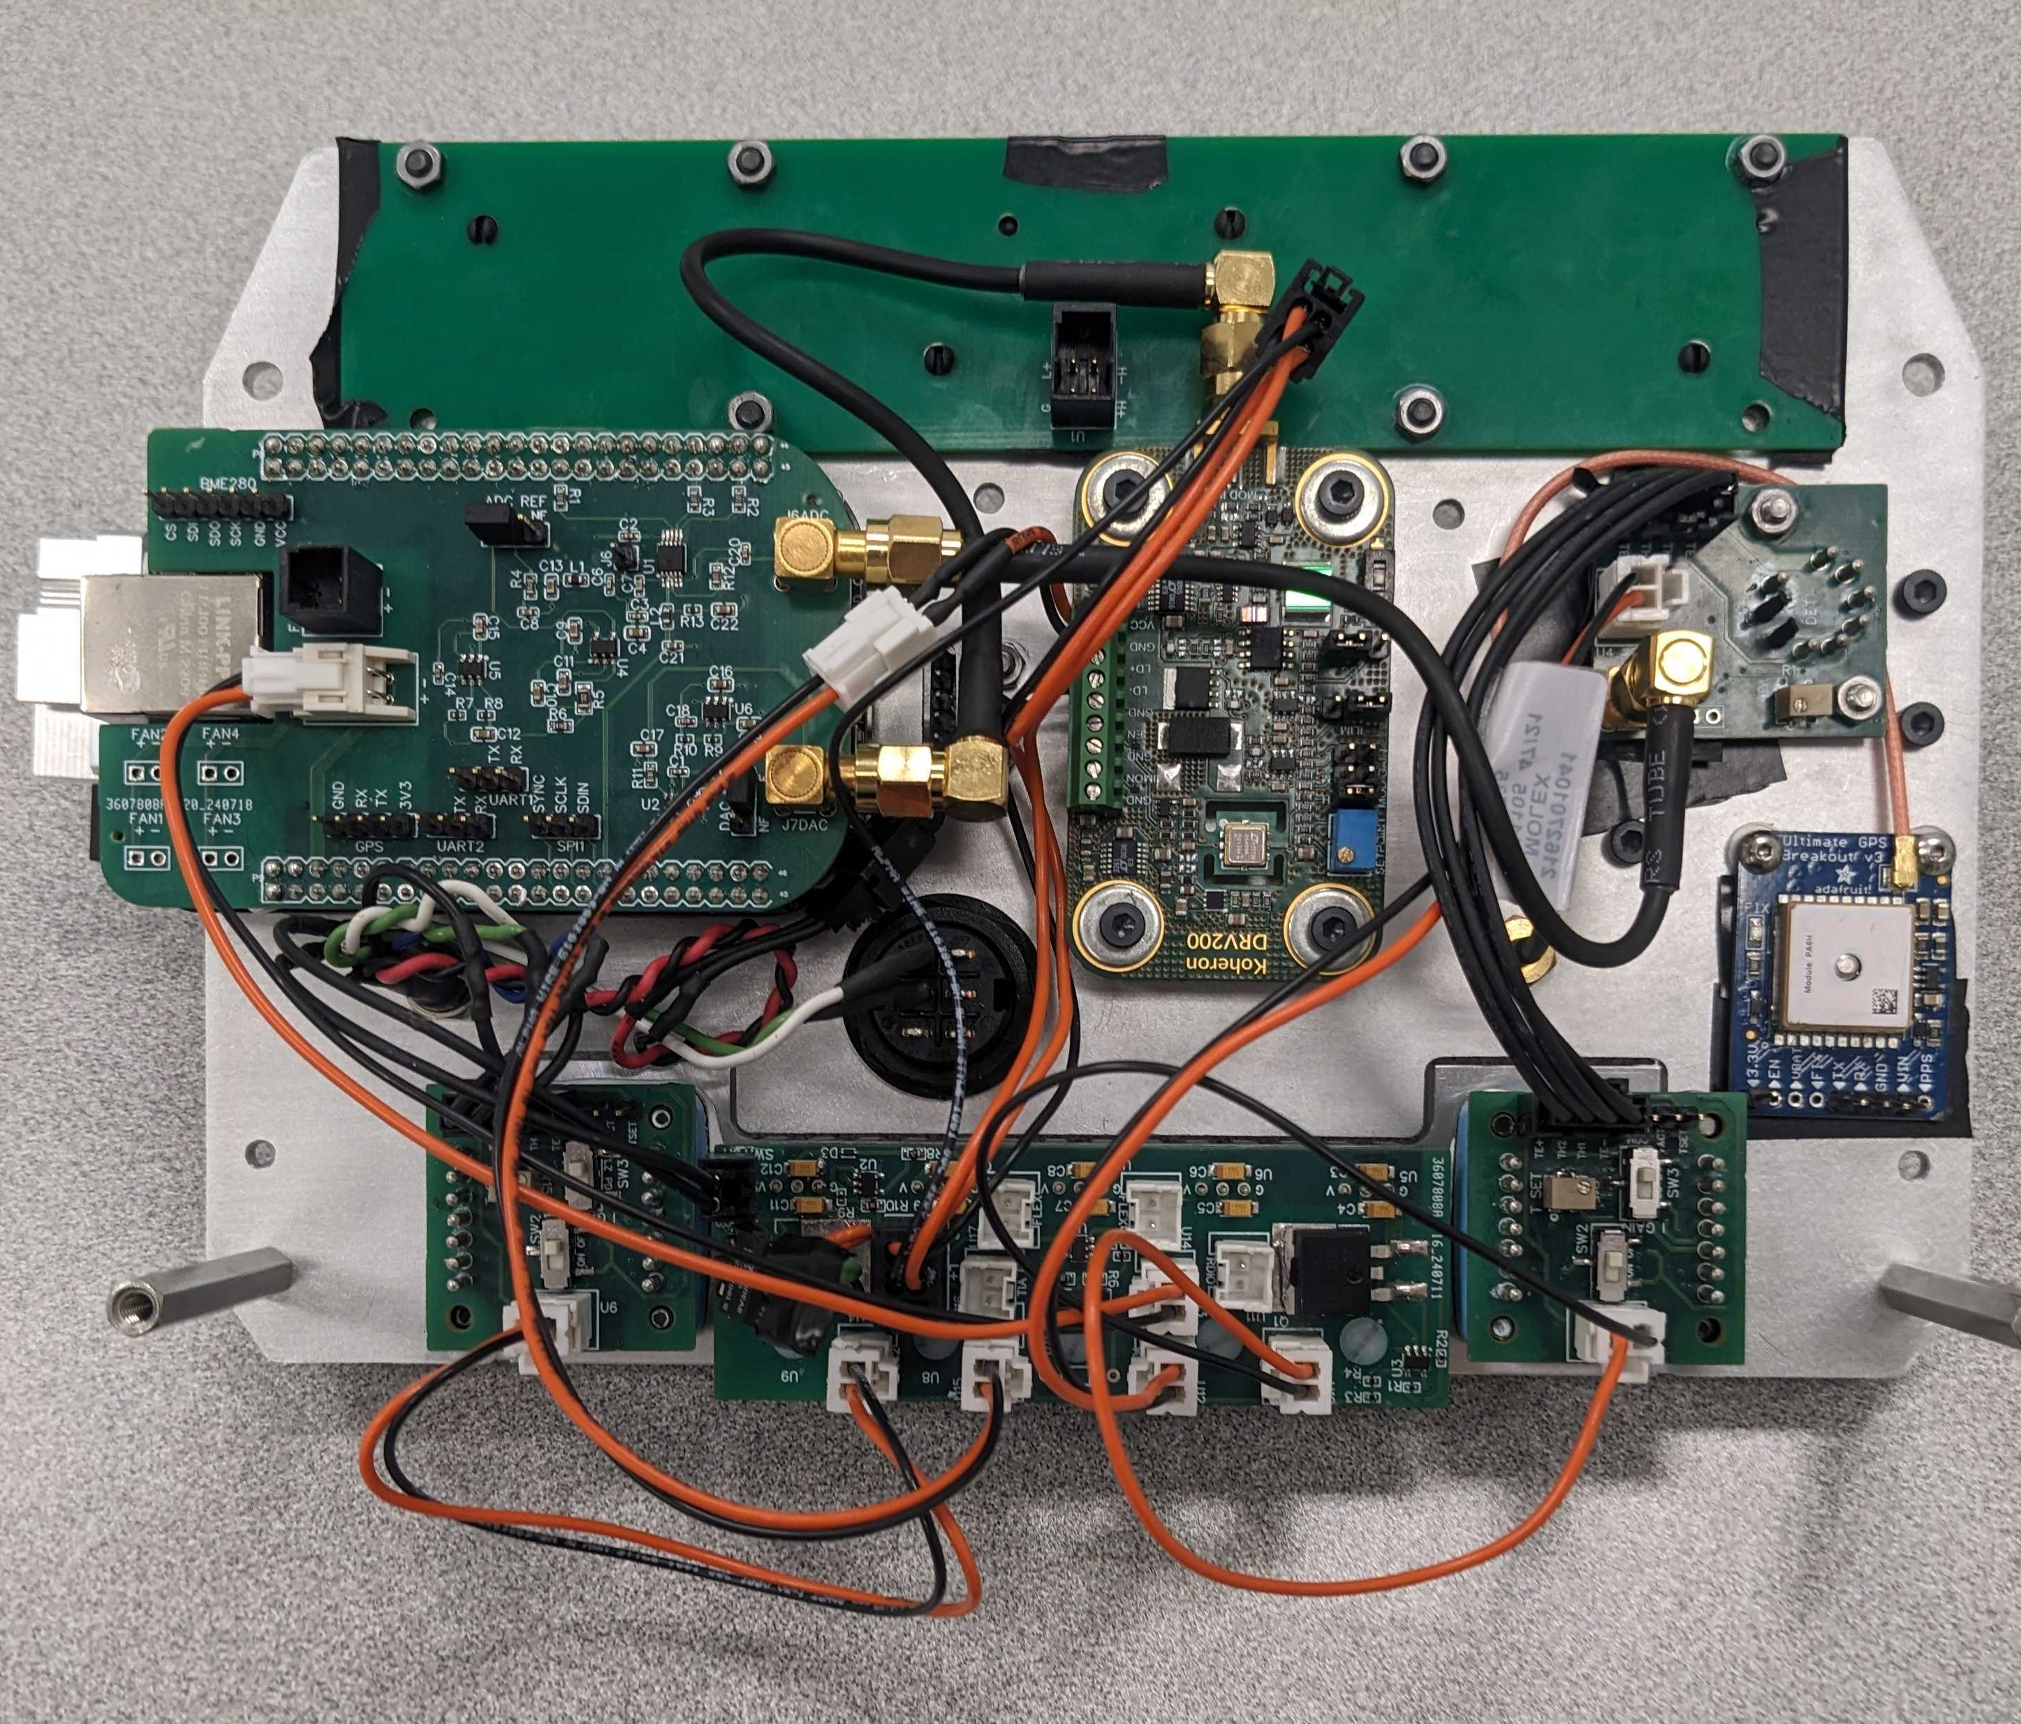
NRC PHANTOM II
An ultra-lightweight, high-sensitivity, UAV deployable green-house gas sensor
EMBEDDED
PCB
OPTICS
MECHANICAL

Slide 2
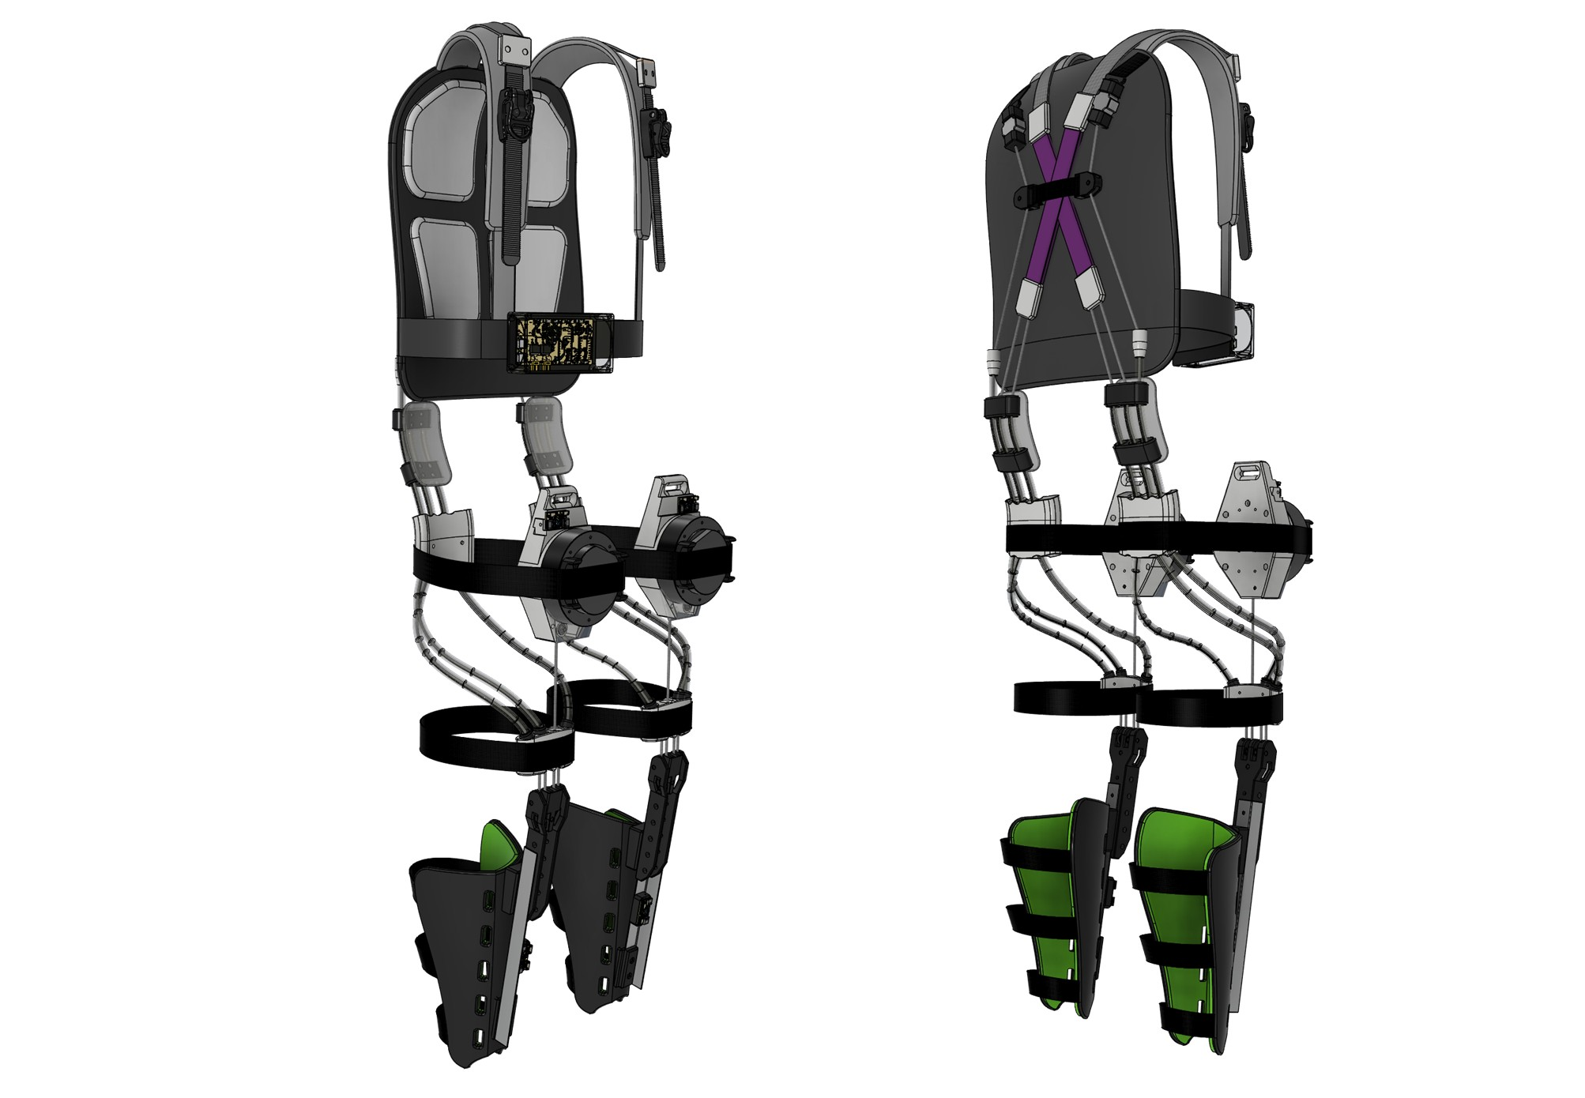
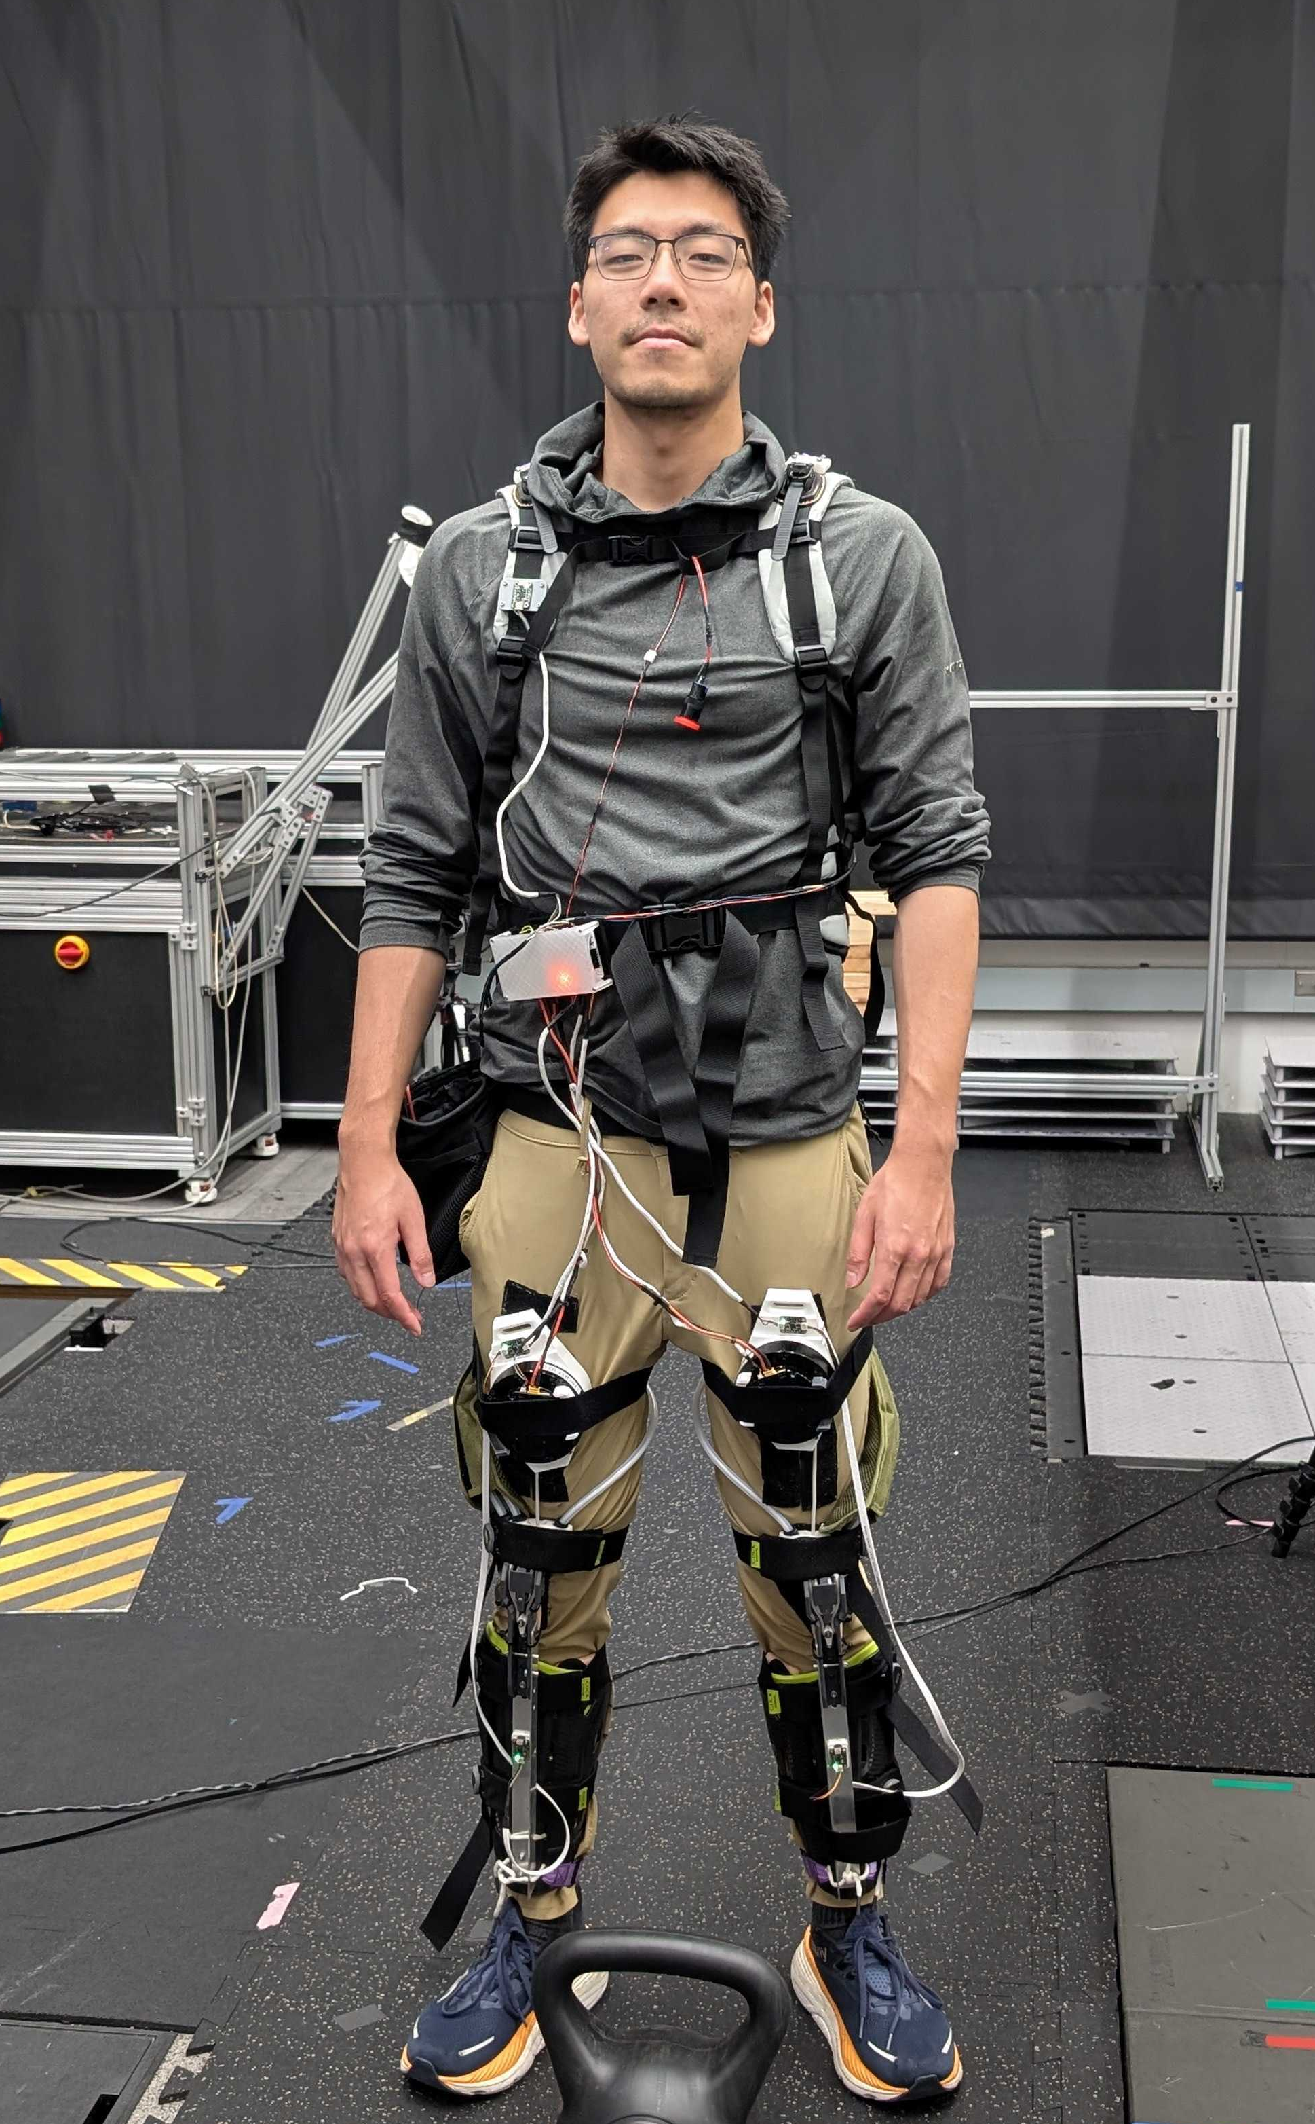
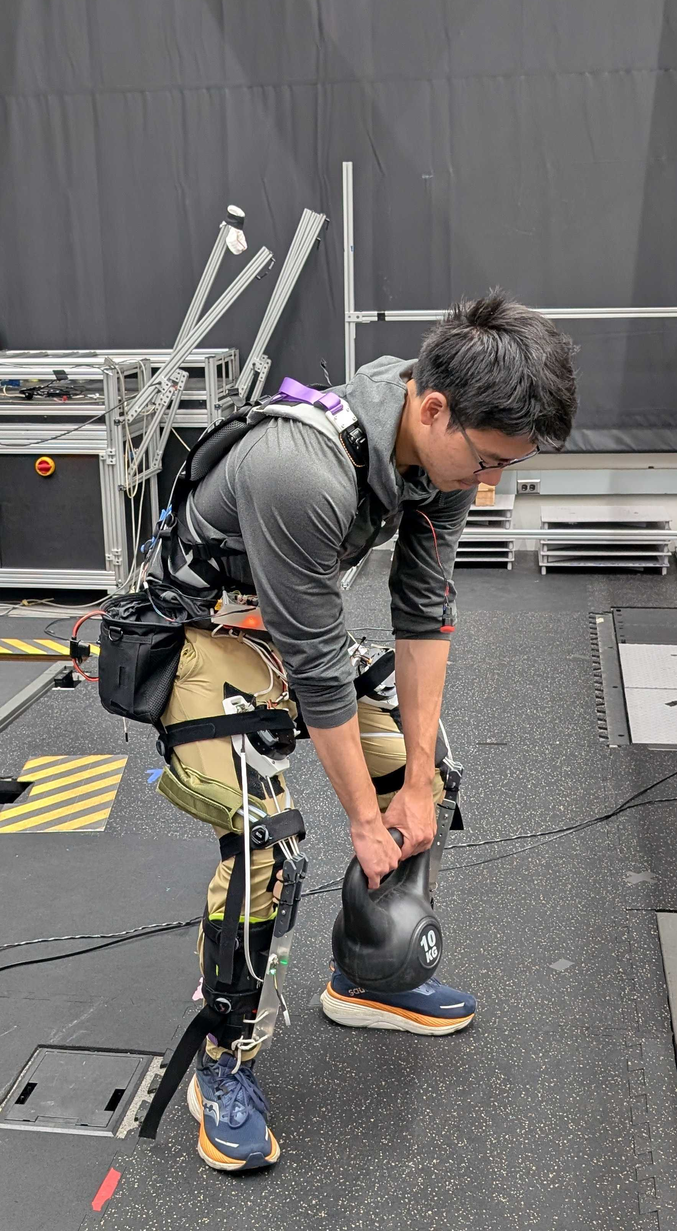
GT MINIFORKLIFT
A hinge-free, under-actuated soft exoskeleton for injury prevention and metabolic cost reduction
EMBEDDED
MECHANICAL
WEARABLE
CONTROLS

Slide 3
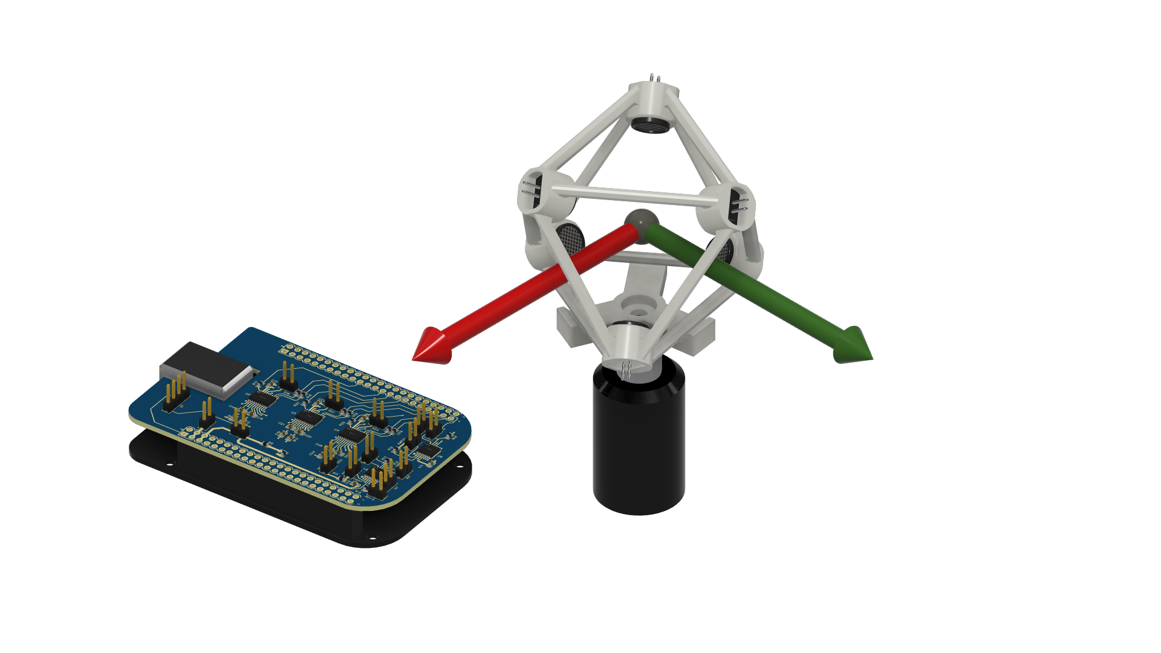
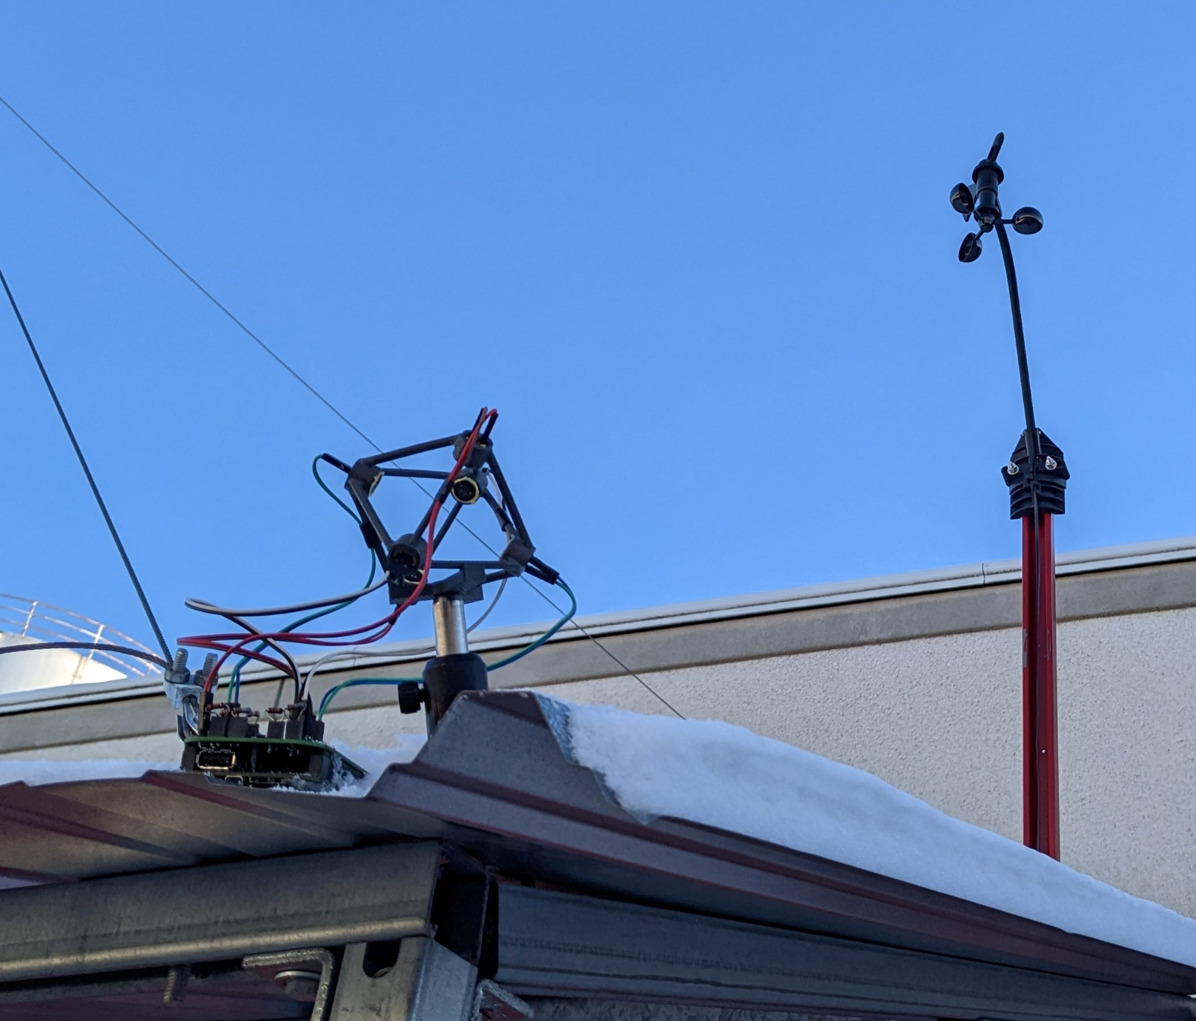
SONIC CHIPPY
A light-weight, high sampling rate wind sensor for air flux calculation
EMBEDDED
PCB
MECHANICAL

Slide 4
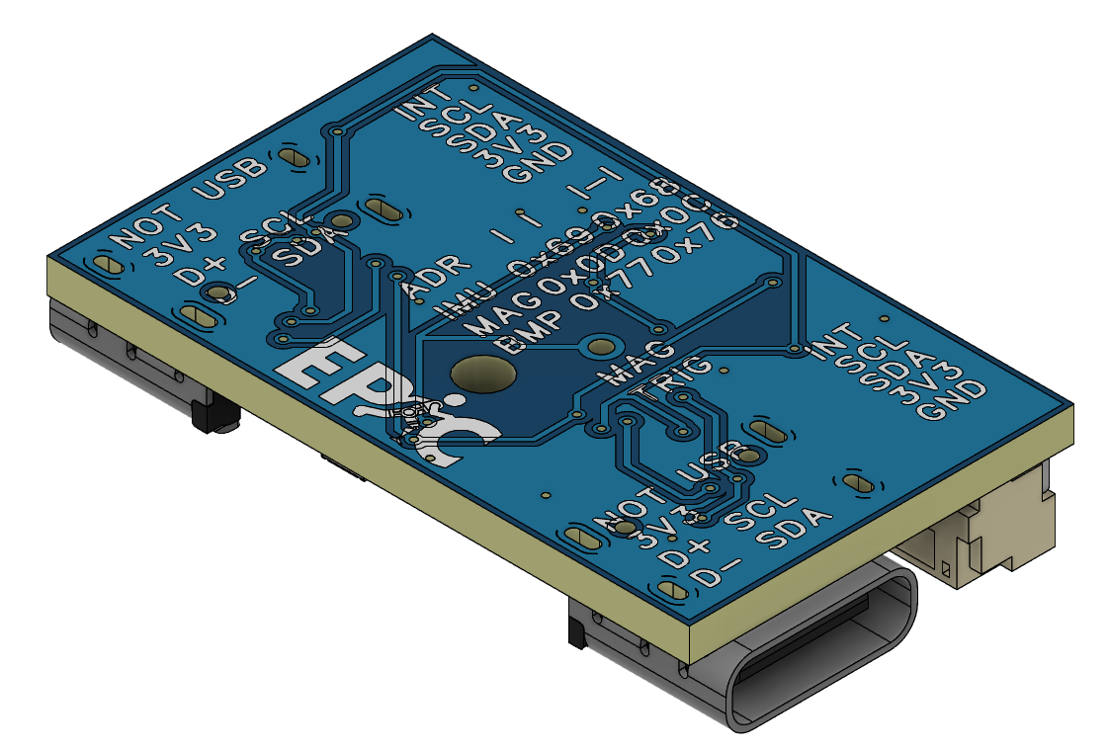
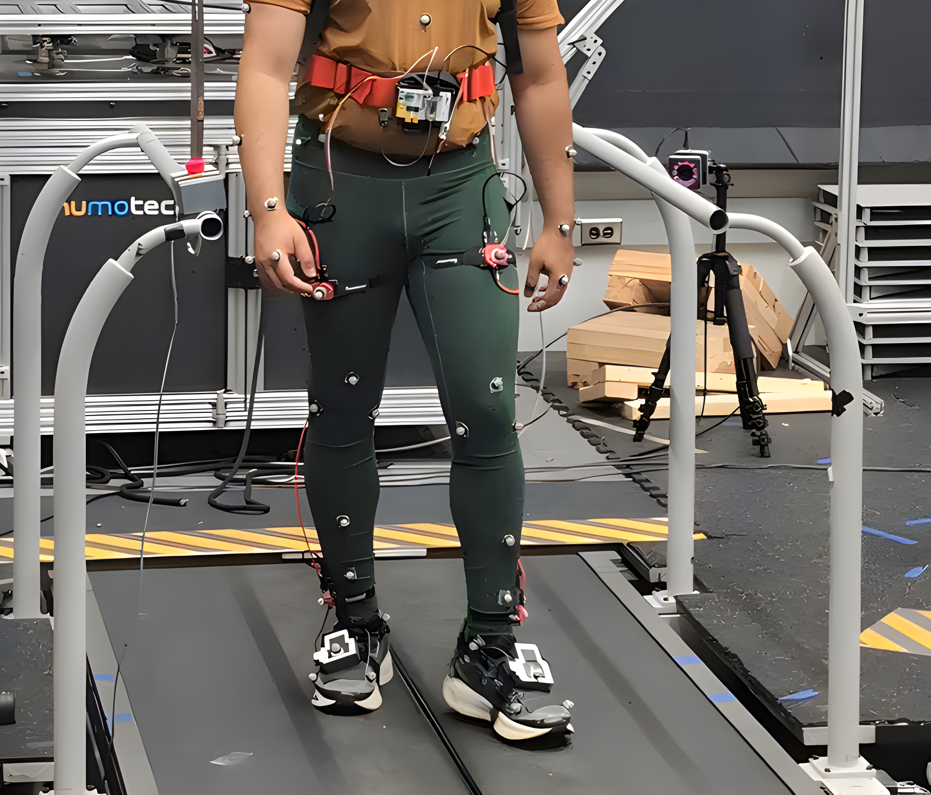
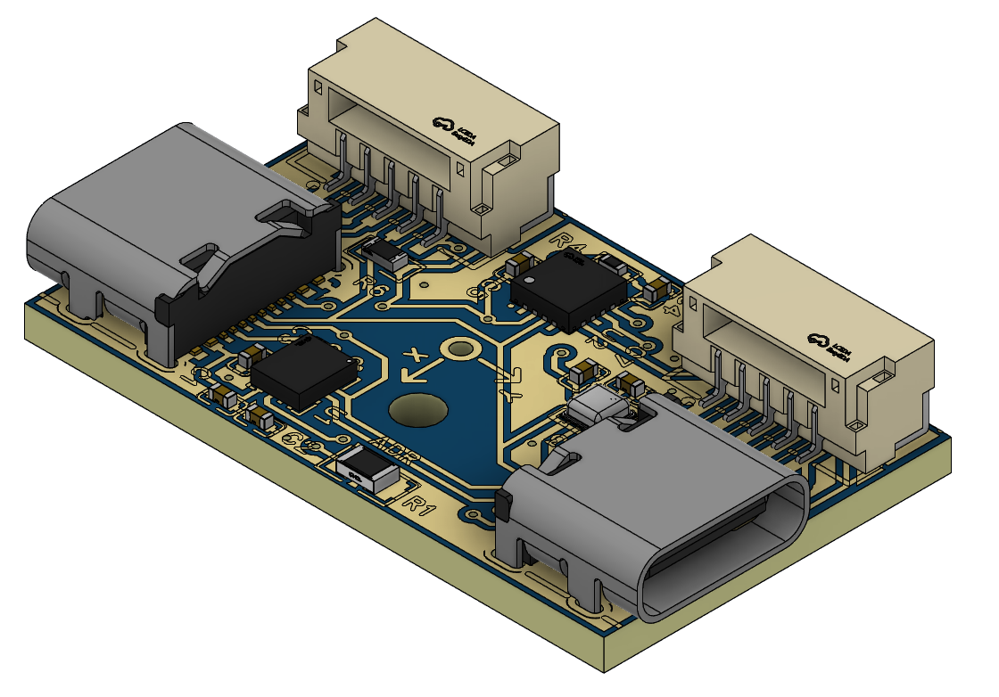
SENSOR SUIT V2
A custom, 9-axis wearable IMU for biomechanics and exoskeleton control
EMBEDDED
PCB
WEARABLE

Slide 5
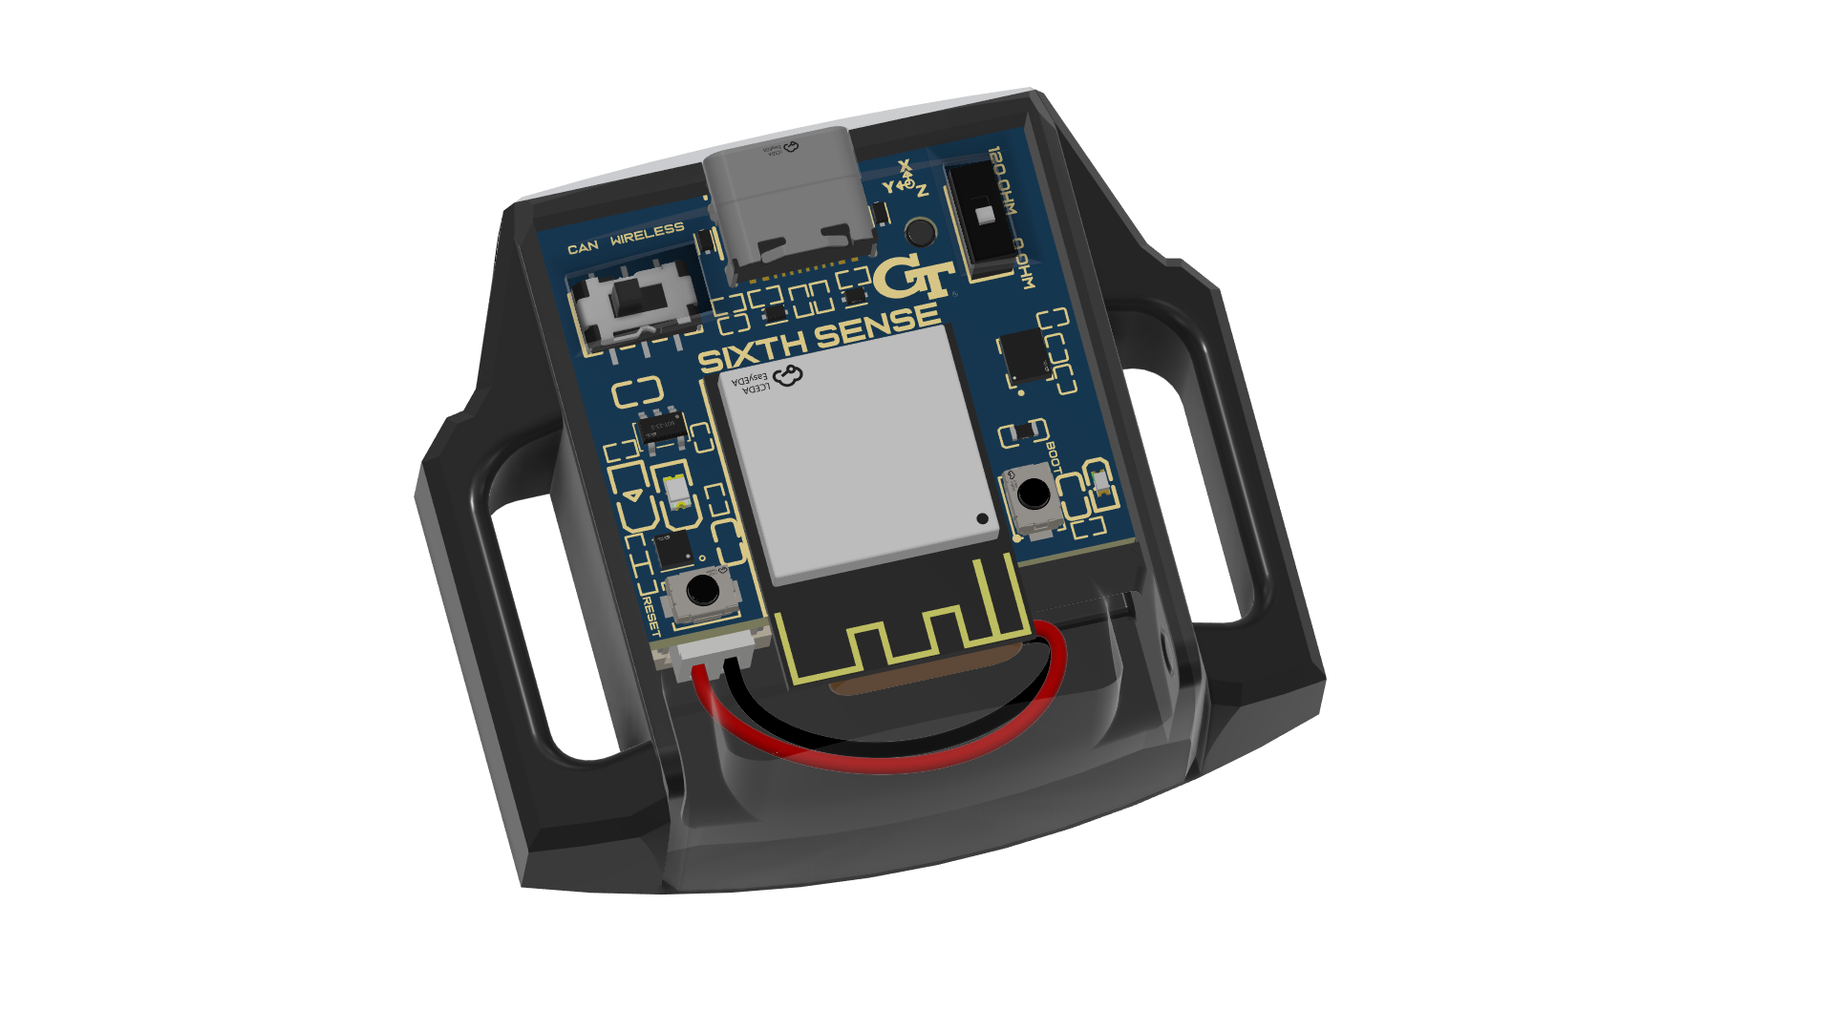
CHASE’S SIXTH SENSE
An open-source, CAN / BLE capable high-precision IMU for wearable robotics and biomechanics
EMBEDDED
PCB
WEARABLE

Slide 6
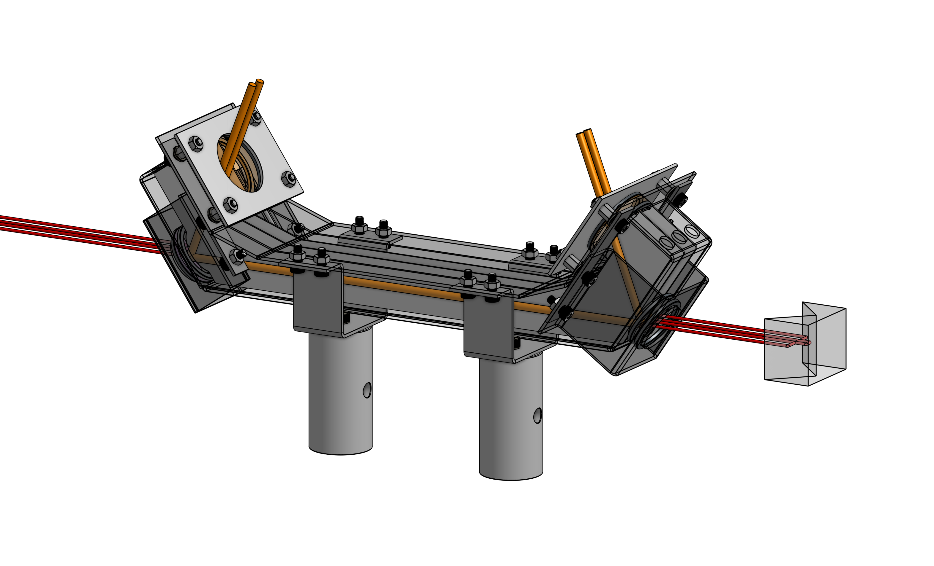
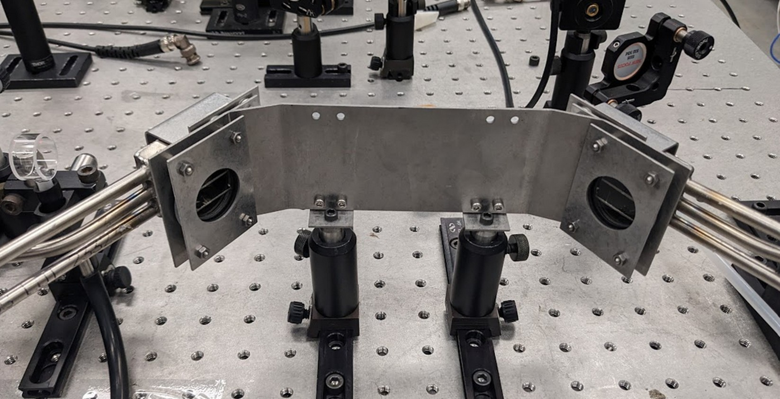
NRC PTI
A flow chamber for a photothermal interferometer for aerosol measurements
MECHANICAL
CAE
OPTICS

Slide 7
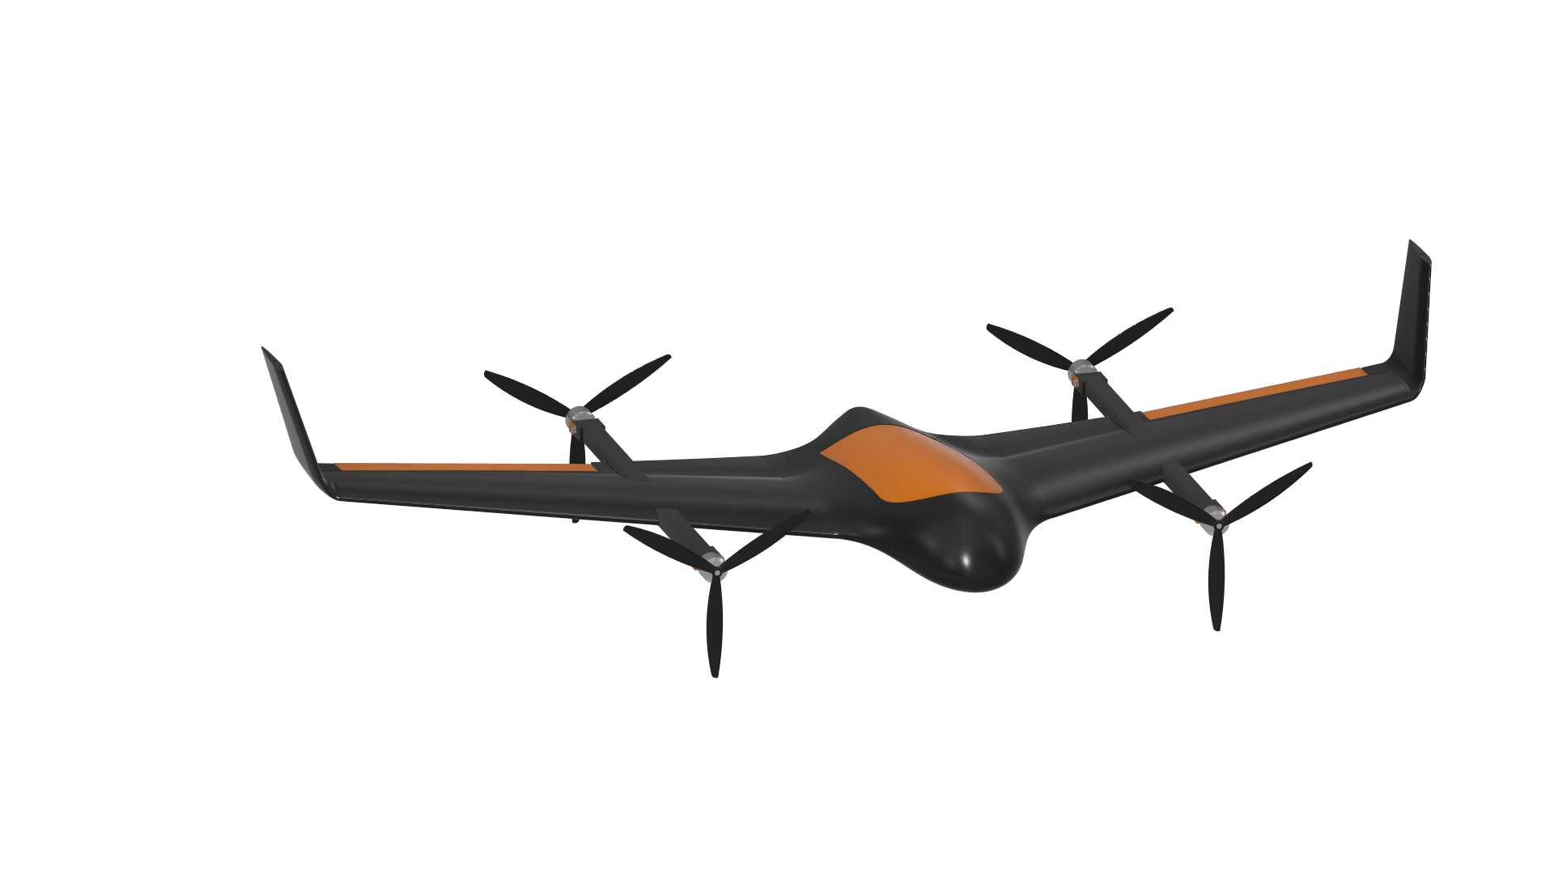
PEREGRINE
A design for a blended-wing body, vertical takeoff / landing (VTOL) UAV
MECHANICAL
CAE

Slide 8
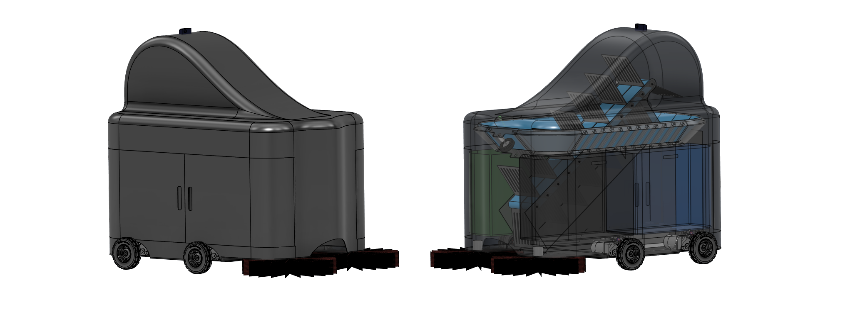
WALL-E JR
A design for a sustainable automated streetsweeper robot for a 36-hour design competition
MECHANICAL

Slide 9
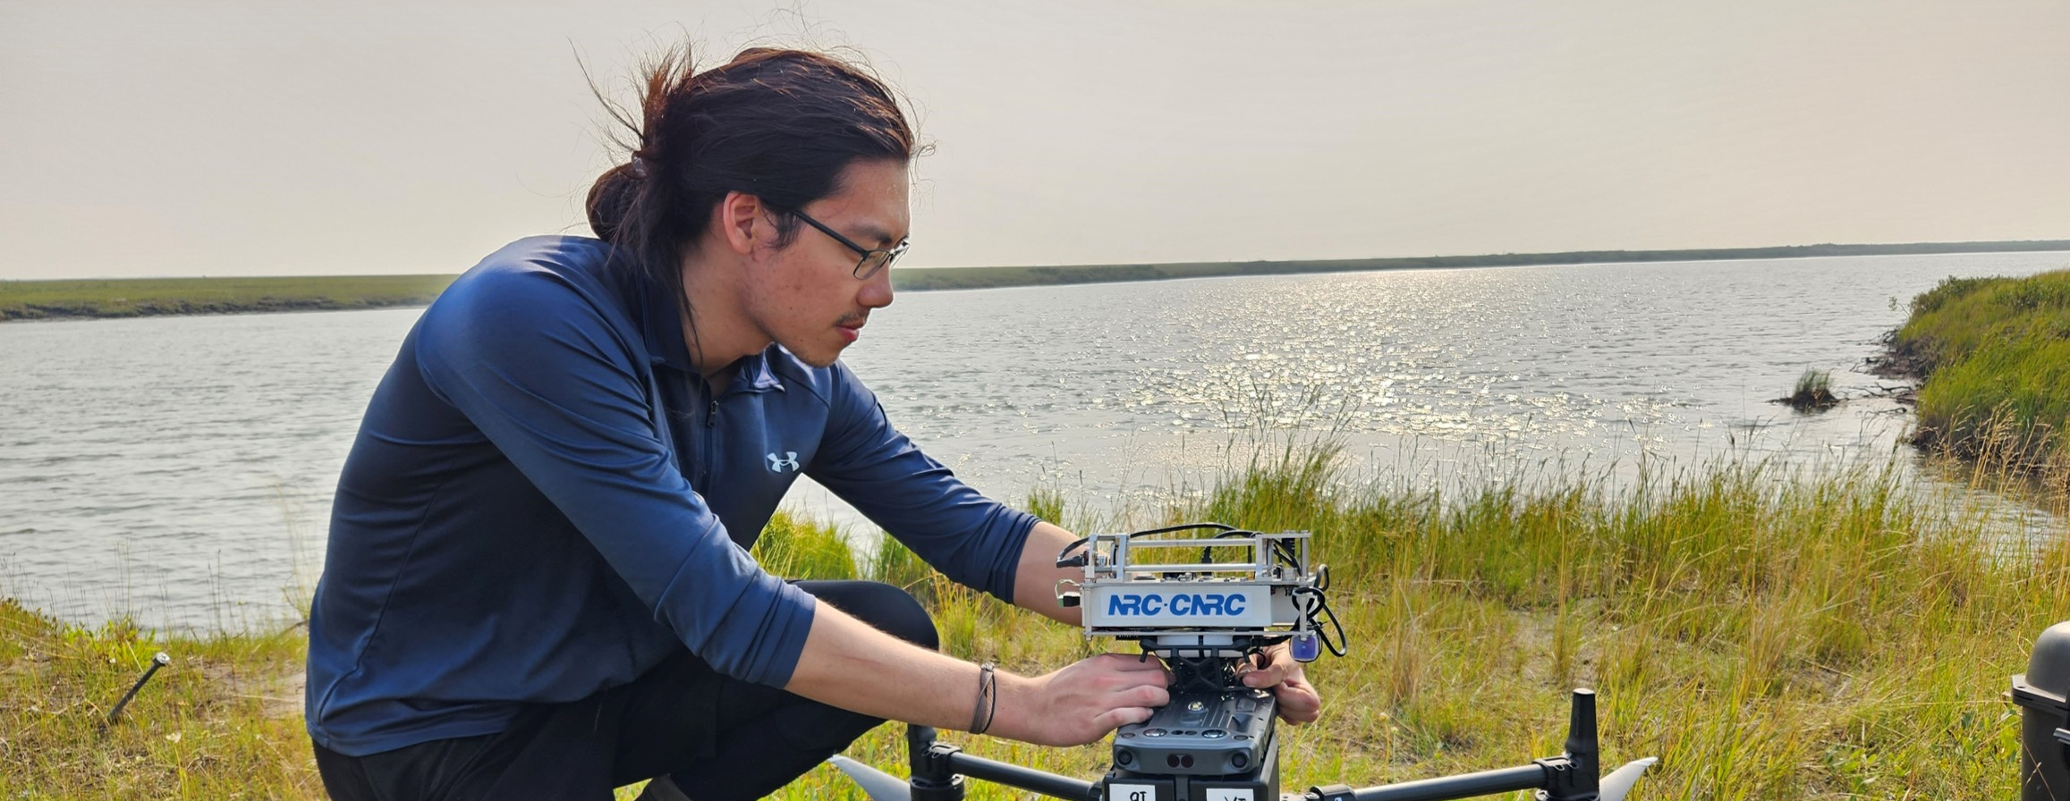



ABOUT ME

